Slide 2
Religious Freedom
Institutional Governance
Stewardship to God
1

Slide 4

2

Slide 6
Supreme Court Cases that
Impact Religious Higher Education
Hosana-Tabor (2012)
Trinity Lutheran Church vs. Comer (2017)
Our Lady of Guadalupe vs. Morrissey-Berru (2020)
Caron vs. Makin (2022)
3

Slide 8
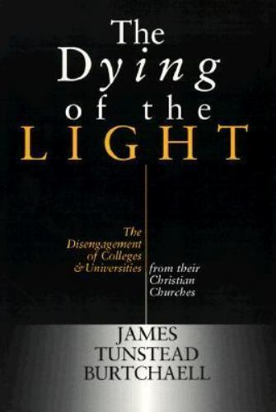
The Need for Clear Governance
Funding Sources
Selection of University Leadership
Faculty Hiring and Review
4

Slide 10
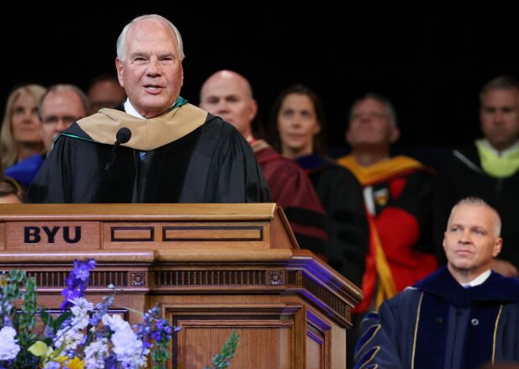
BYU’s Prophetic Governance
“In the case of Brigham Young University, it is important to recognize that the governance of this institution operates under the guidance of a unique and distinctive board of trustees…”
“The BYU Board of Trustees is led by the First Presidency, with President Russell M. Nelson serving as chairman.”
- Elder Ronald A. Rasband, BYU Inauguration 2023

Slide 12
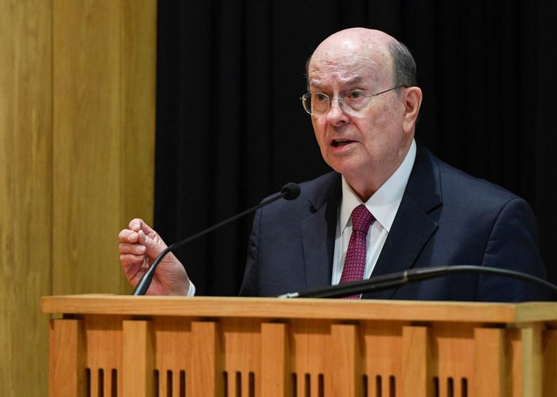
A Stewardship to God
“There is no better demonstration of the great benefits associated with religious liberty than for devoted members of various faiths who feel accountable to God to model principles of integrity, morality, service, and love.”
- Elder Quentin L. Cook, Pembroke College, October 2019

Slide 14
Three Characteristics of Our Stewardship to God
Leave the Forest
Have Clarity of Conviction
Bless and Serve Others
7

Slide 16
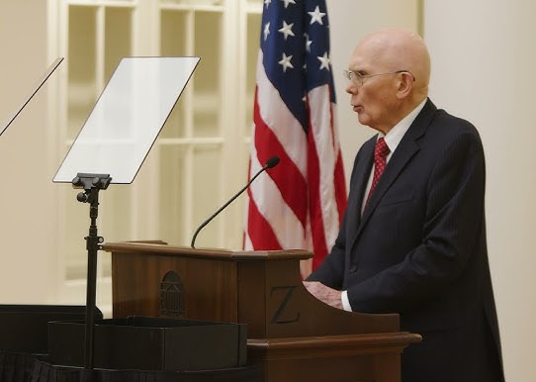
Civic Stewardship
“We have always had to work through serious political conflicts, but today too many approach that task as if their preferred outcome must entirely prevail over all others, even in our pluralistic society. We need to work for a better way–a way to resolve differences without compromising core values.”
- President Dallin H. Oaks, University of Virginia, November 2021

Slide 17
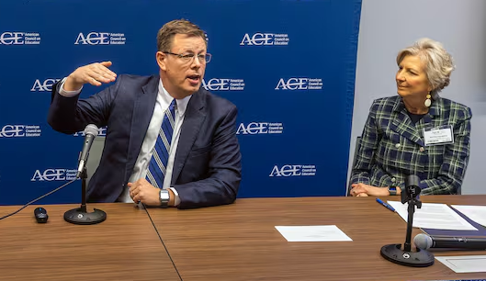
Civic Stewardship
9

Slide 19
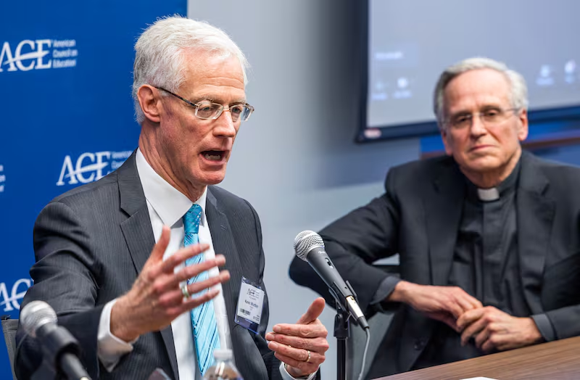

Intellectual Stewardship
10

Slide 21
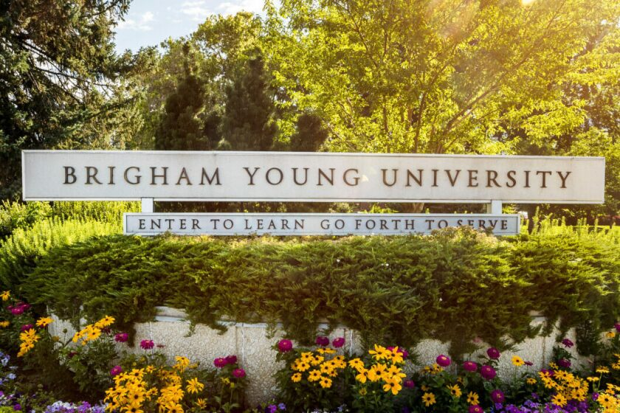

Ministerial Stewardship
11

